Slide 1
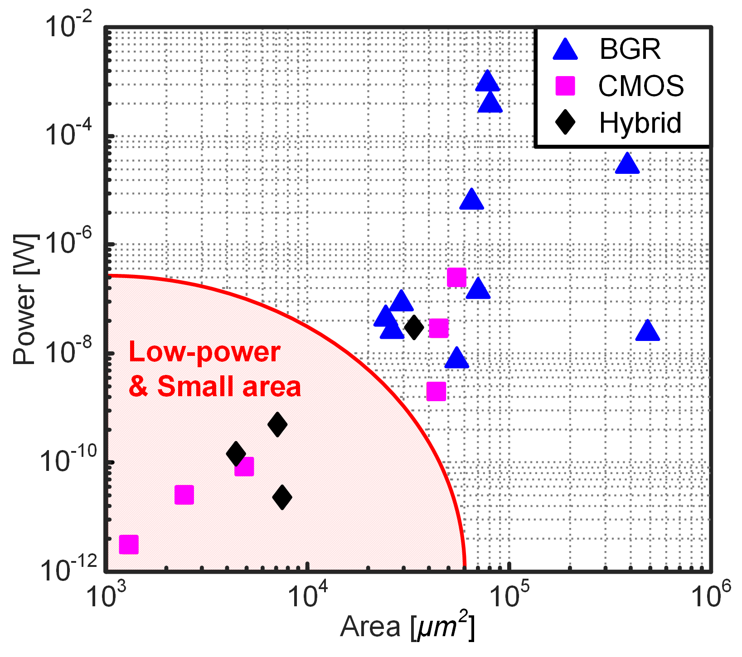
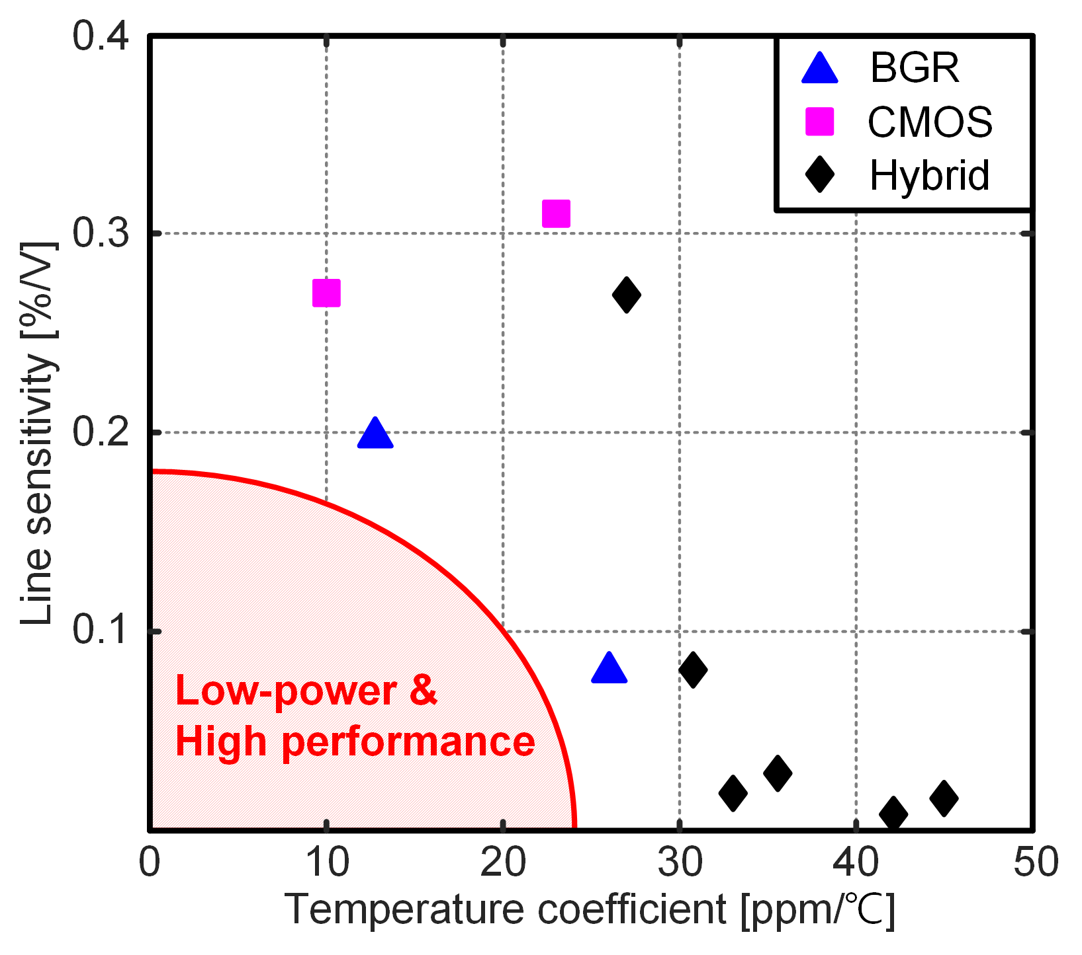
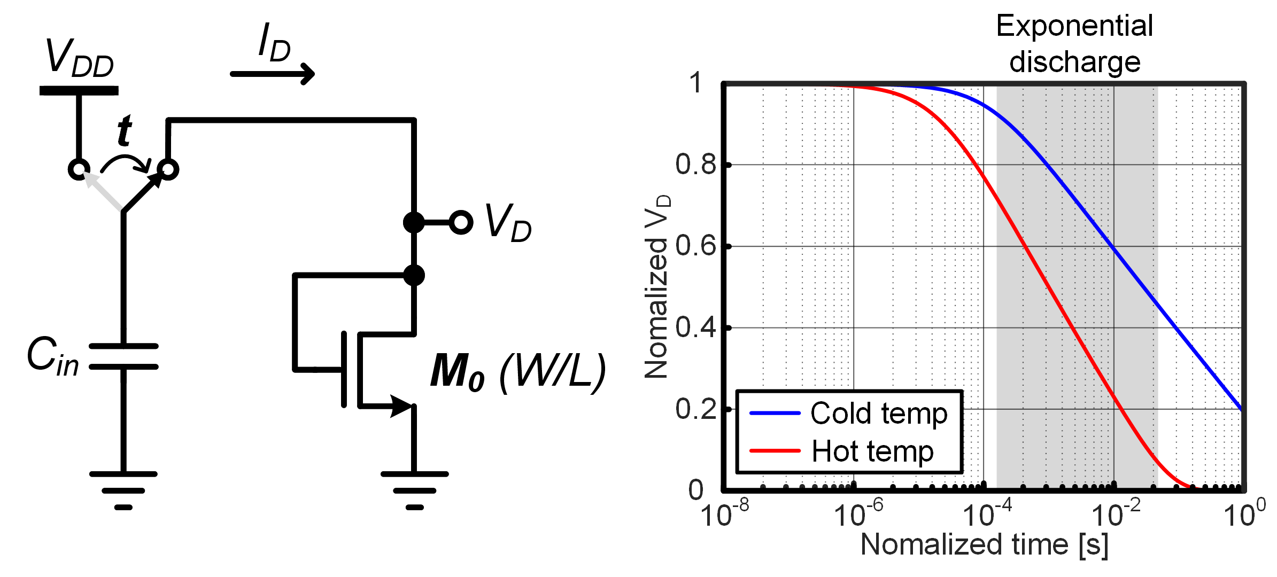
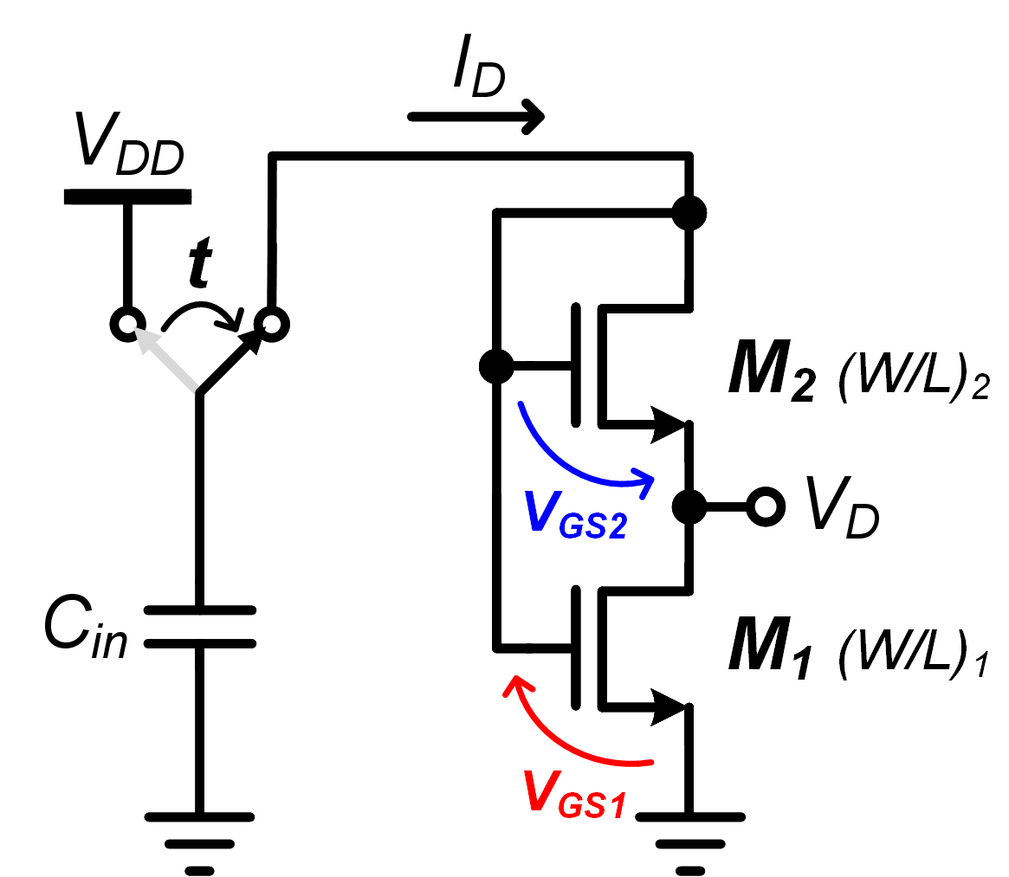
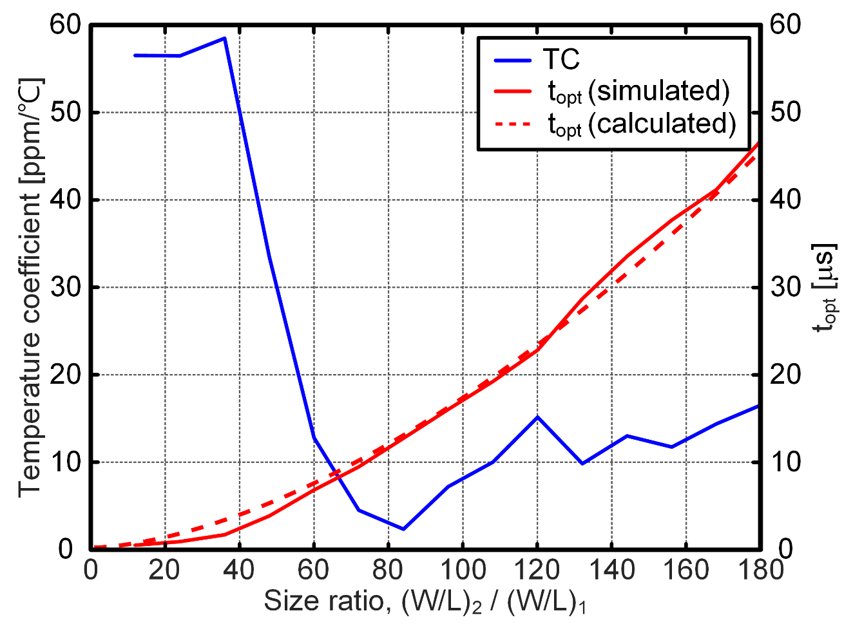
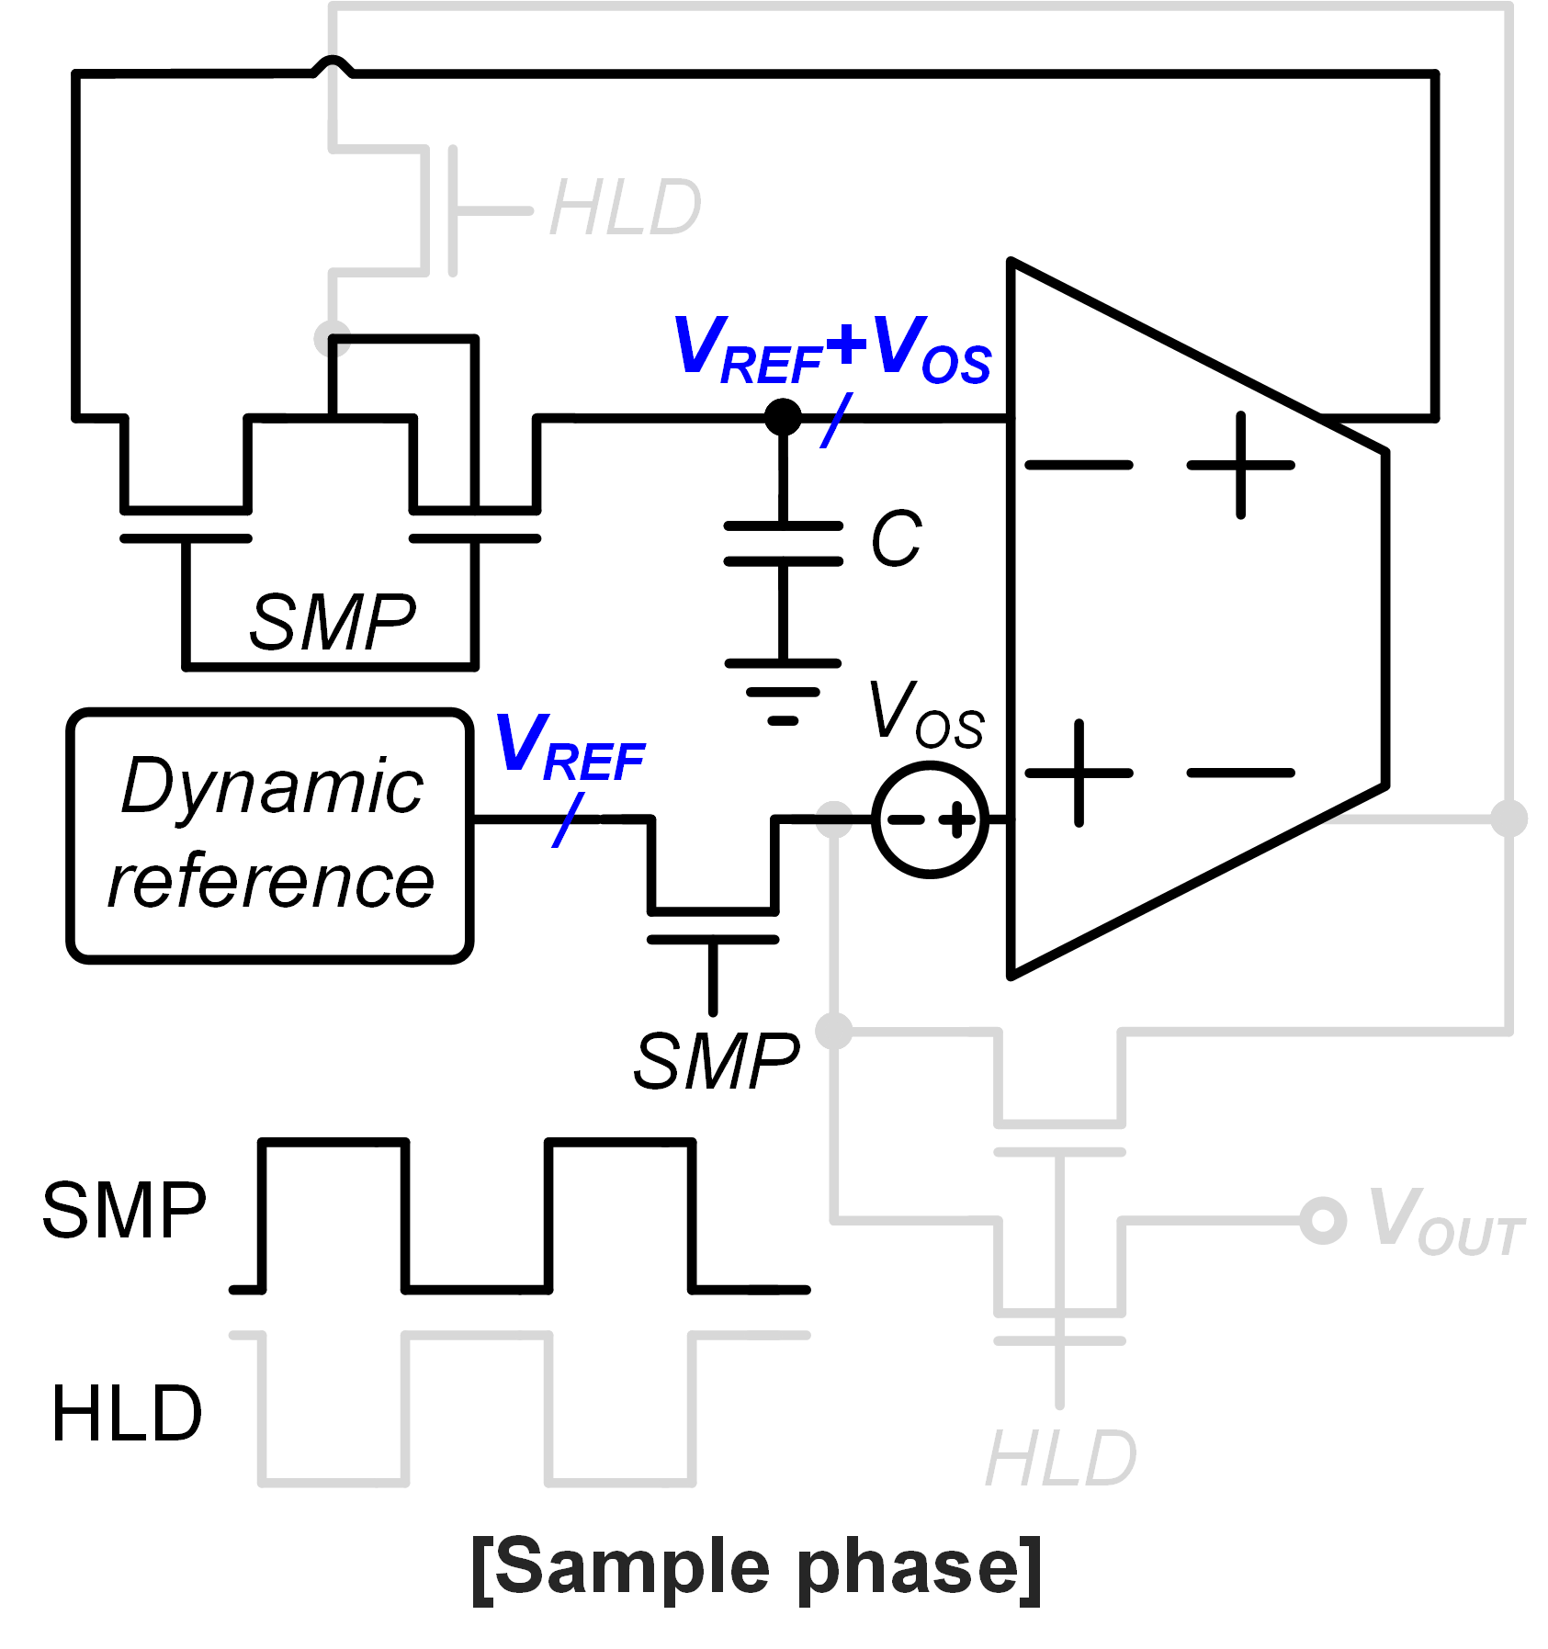
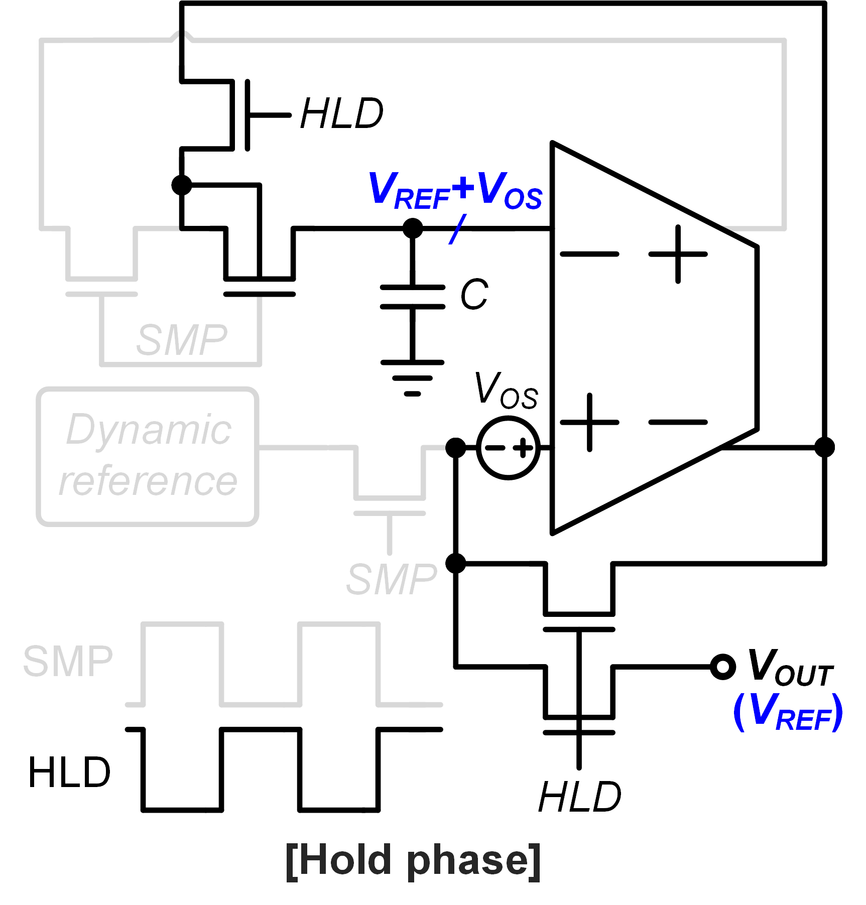
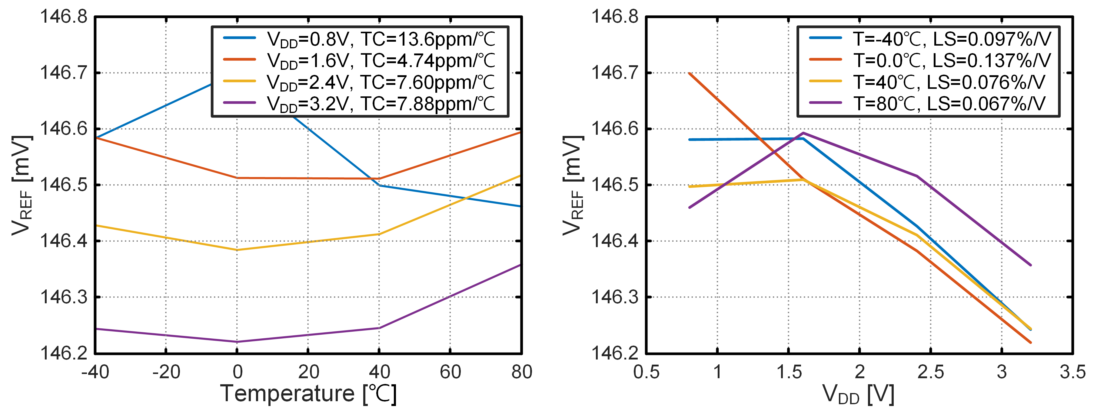
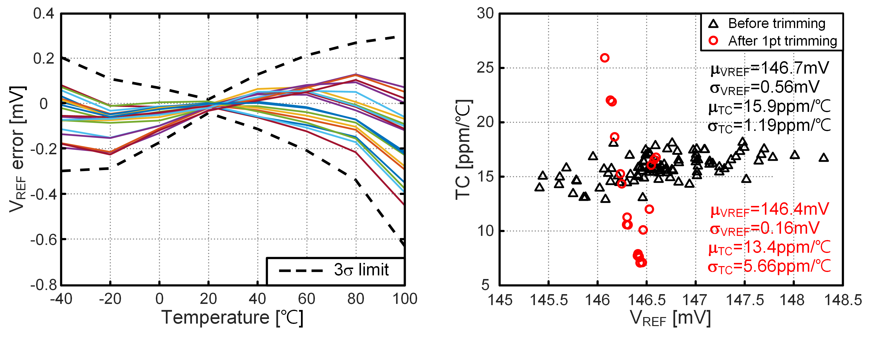
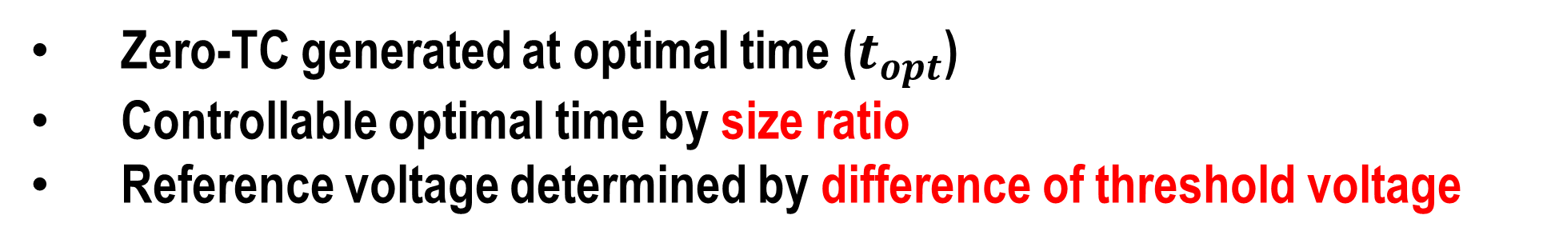

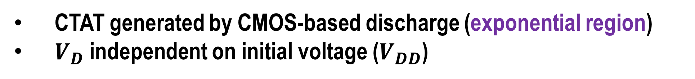
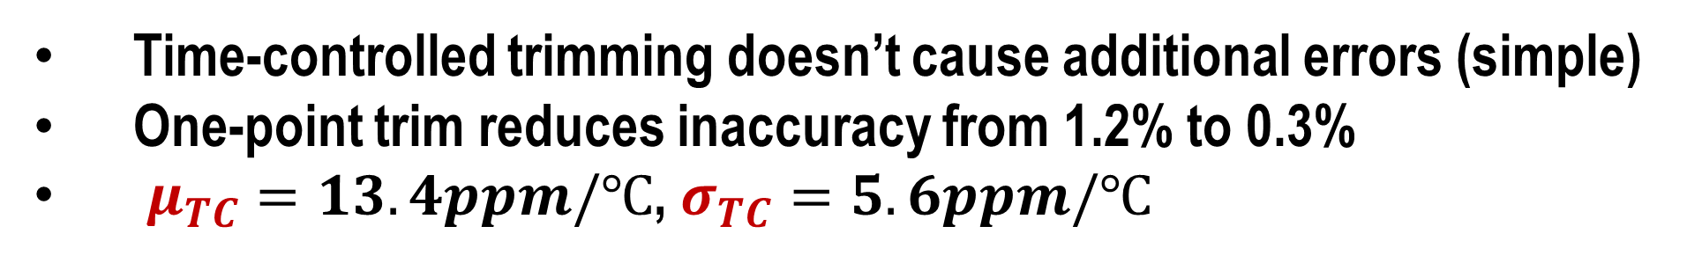

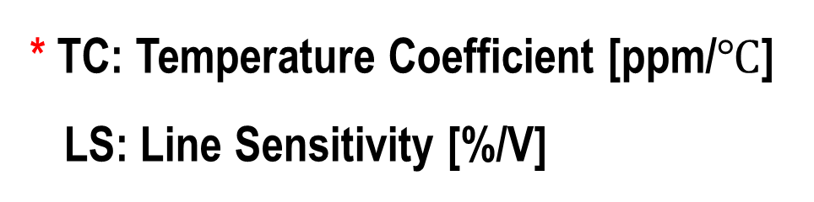

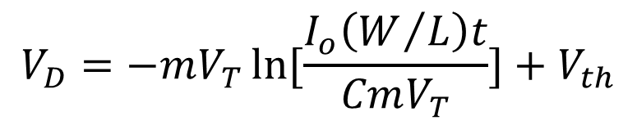
A 0.7V Nano-Power Dynamic Voltage Reference for IoT Applications
Heungsik Eum and Youngcheol Chae
Department of Electrical and Electronic Engineering,
Yonsei University, Seoul, Korea
Motivation
Dynamic Reference
Power consumption vs Area
Performances of Reference
CMOS-based Discharge
$$V_{D}=−mV_{T}\ln{[\frac{I_{o}\left(W/L\right)t}{CmV_{T}}]}+V_{th}$$
Voltage reference for IoT applications should have low-power consumption & small area occupation
Better * TC & LS both are required in voltage reference for IoT applications (<100nW)
CTAT generated by CMOS-based discharge (exponential region)
$V_{D}$ independent on initial voltage ($V_{DD}$)
Proposed
* TC: Temperature Coefficient [ppm/$℃$]
LS: Line Sensitivity [%/V]
Auto-zeroing Long-hold Buffer
$$t_{opt}=[\frac{{(W/L)}_{2}}{{(W/L)}_{1}}]^{α}(\frac{m_{1}}{I_{o1}})^{α+1}(\frac{I_{o2}}{m_{2}})^{α}\frac{CV_{T}}{(W/L)_{1}}exp\left[\frac{1}{m_{1}−m_{2}}\frac{q}{k}(C_{VTH1}−C_{VTH2})\right]$$
$$V_{D}\left(t_{opt}\right)=V_{REF}=−T∙∆C_{VTH}+∆V_{TH}=∆V_{TH0}$$
$$∗α=\frac{m2}{m1−m2}$$
Zero-TC generated at optimal time ($t_{opt}$)
Controllable optimal time by size ratio
Reference voltage determined by difference of threshold voltage
Conclusion
Reference voltage should be buffered for measurements
Offset cancelation by auto-zeroing
Bulk-source connection & buffer block bulk leakages
Simulation Results
Trimming Method
Trimming by time ($t_{opt}$)
Better performance of TC (<13.6ppm/$℃$) and LS (<0.137%)
Low-supply & low-power operation
Time-controlled trimming doesn’t cause additional errors (simple)
One-point trim reduces inaccuracy from 1.2% to 0.3%
$μ_{TC}=13.4ppm/℃$, $σ_{TC}=5.6ppm/℃$

